Slide 1
Why Computer Scientists Don’t Use Databases
Basically Everyone Except My Bank
Biologists
Physicists
Sam Madden

Slide 2
The Answer
Benefit(DBMS) ≠ Suckiness(DBMS)
Disadvantages of DBMSs are growing
Impoverished data manipulation language
Lack of modern cleaning and modeling tools
Advantages of a DBMSs are shrinking
Large data sets? Transactions? High-level languages?
DBMS setup & boundary crossings painful
Especially if you have to do it multiple times!
MATLAB
Python
awk
Regression
Graphical models
Interpolation

Slide 3
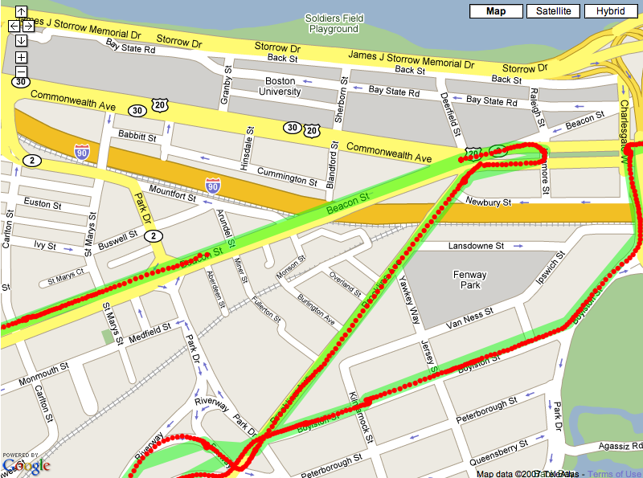
Example
CarTel - ~1M GPS points per day from a fleet of 40 cabs on Boston streets
Pipeline
Raw data in DBMS
Trajectories with Matlab
Queries with SQL
Route Planning with C++
Visualization on Google Maps
Database isn’t the most valuable tool in this picture
Import/Export is non-trivial
Database is least flexible tool, requires most maintenance
IMPORT
EXPORT
IMPORT
EXPORT
EXPORT

Slide 4
Two Solutions
Decrease Frequency of Boundary Crossings
Cram more stuff into the DBMS
FunctionDB
Probabilistic databases
ArrayDBs
XML
…
Notes:
If we want to be relevant to any

Slide 5
FunctionDB
DBMS that can fit continuous functions to raw data, query data represented by these functions using SQL
Regression
Function temp(t)
Raw data (temp readings)
Solve equation
temp(t) = thresh
Query: Report when temp crosses threshold
SELECT time WHERE temp = thresh
time

Slide 6
Two Solutions
Decrease Frequency of Boundary Crossings
Cram more stuff into the DBMS
FunctionDB
Probabilistic databases
ArrayDBs
XML
…
Decrease Pain of Boundary Crossings
Don’t insist on DBMS-specified storage representation
Text and fileystem based tools to manage, edit, manipulate data
Don’t insist on SQL
Don’t insist on structured data
Add transactions, rollback, lineage to Unix toolchain and filesystems
> checkpoint data.txt
> awk -f process.awk data.txt > data.txt
> history data.txt
awk process.awk
> rollback data.txt
If you can’t beat them, join them

