Slide 1
Approximation and Interaction:
A Progressive’s View
Joe Hellerstein

Slide 2
Outline
1
Perspective
2
Interactive as Distributed
3
Async Interaction
4
CALM Progress
5
More Progress

Slide 3

Perspective
Distributed Systems
Visualization/Interaction
Machine Learning
Through a
data-centric,
declarative lens

Slide 4

Systems and Services
Many discrete low-latency tasks x -> T(x)
Multi-user
Concurrent, session-oriented
Mutable state

Slide 5
Services as Stream Queries
One stream (uid, sid, x) -> Q(uid, sid, x)
Partitioned by user, session
State evolution as a log
  the “kappa architecture”?
Goes deeper:
  Both system internals & application logic
  implemented as stream queries
[ACHM11, CMA+12]

Slide 6
Progressive Systems: Monotonic by Nature
Most services make forward progress only:
monotonic queries over unbounded streams
  New inputs only cause new outputs – no retractions!
Benefits: replication, partitioning, lineage debugging…
  Declarative networking, database & distributed systems
  [P2 LCH+05], [DSN CPT+07], [Evita CCHM08], [BOOM ACC+10a], [IDo ACC+10b], [ExSpan ZST+10], [LogicBlox AtCG+15]
  Convergent Replicated Data Types
  [Treedoc LPS10], [CRDT SPBZ11], [RedBlue LPC+12]
  CALM Theorem: Coordination-Free Consistency
  [Hel10], [ANVdB13], [ZGL12], [AKNZ16]

Slide 7
Progressive Systems
How might this be relevant to
long-running interactive tasks?
Surprise (?): that’s where it all started!

Slide 8
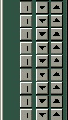

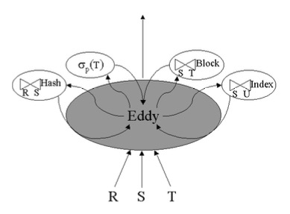


A Progressive’s Progress
Online Aggregation
Adaptive Dataflow
Stream Processing
Declarative Networking
Declarative Distributed Systems

Slide 9
A Progressive’s Progress
How does the later work on declarativity and monotonicity reflect back?
On Interaction? Approximation?
  Results and open questions…

Slide 10
Outline
1
Perspective
2
Interactive as Distributed
3
Async Interaction
4
Outline Item
5
Outline Item

Slide 11
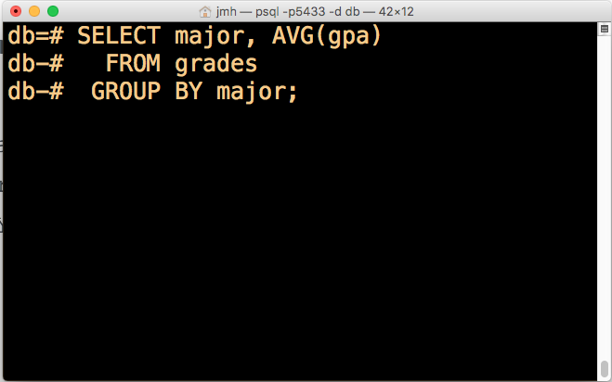

Interfaces c. 1995 … and in our era of Big Data
Lack of feedback
Coarse-grained user control
  query
  cancel
Online Aggregation can help
  Continuous approximation
  But what is the User Experience?
Lack of user feedback
Coarse-grained user control
  query
  cancel

Slide 12
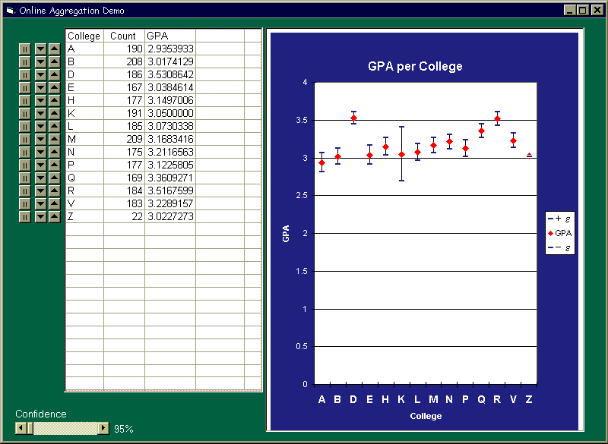
An Interface for Online Aggregation
Progressive animation
  approximation
  confidence
  rate of change
Visual update-in-place
  mutable state!?
With thanks to Bruce Lo, 1997

Slide 13
Interaction Starts with Eye
Output is progressively interpreted by a human
Human input is also an important stream
What is in the middle of this control loop?

Slide 14
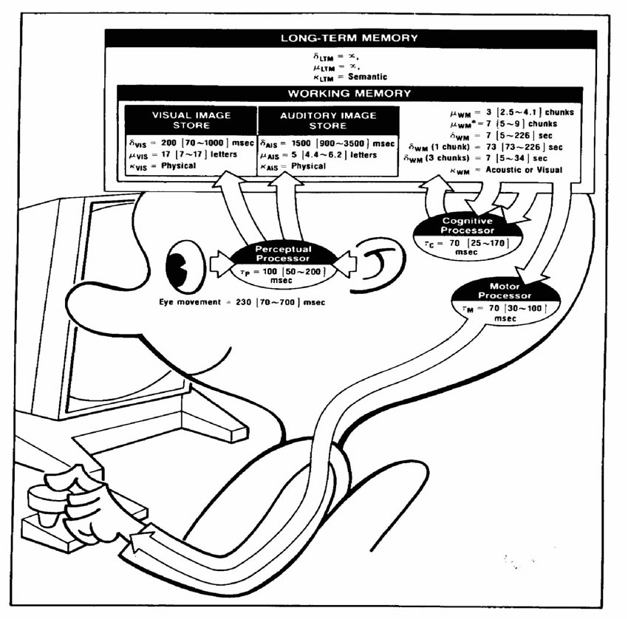
The Model Human Processor
Card, Moran, Newell ’83 [CMN83]

Slide 15
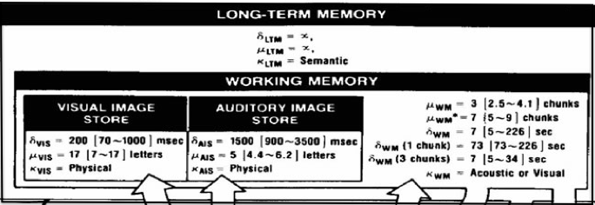
A Distributed System…
Cloud

Slide 16
…With Distributed Systems Problems
Lost messages
Batched message
Reordered messages
Performance variance, component failure
Heterogeneous storage and compute

Slide 17
Architectural Concerns
Huge data volumes
Large-scale computation
Limited Memory
High context switch cost
Low BW, Intermittent
High latency

Slide 18
Consistency Challenges
Evolving
Distributed State
Σ_{i,t}s_{i,t}
V_{t} M_{t}
Lossy memory of visual and
semantic history
Evolving distilled
visual representation
V_{t} = f (Σ_{i,t}s_{i,t})
Lossy perception and
semantic understanding
High latency

Slide 19
I’m Living This

Slide 20
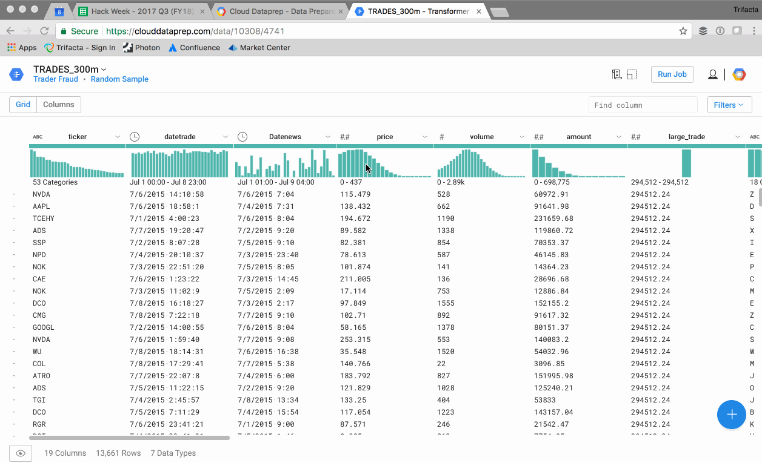
I’m Living This

Slide 21
Outline
1
Perspective
2
Interactive as Distributed
3
Async Interaction
4
CALM Progress
5
More Progress

Slide 22
Asynchronous Data Visualization
Chronicled Interactions
Joint work with Yifan Wu, Larry Xu, Eugene Wu, Remco Chang

Slide 23
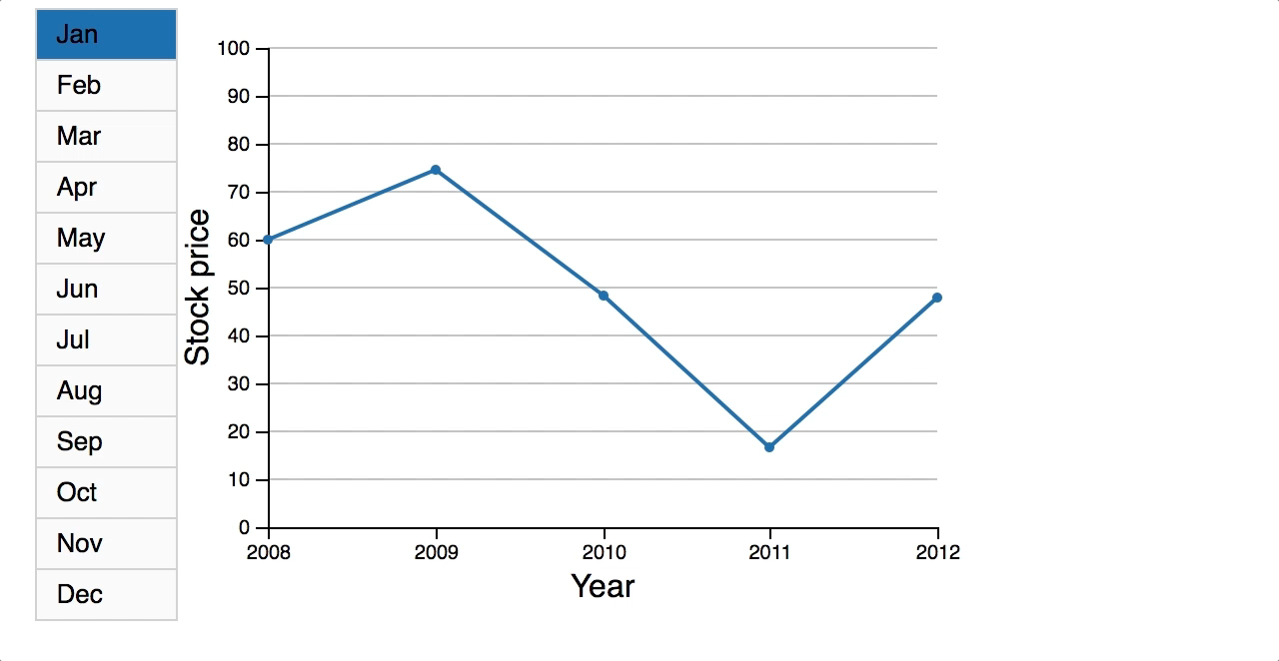
A Simple (?) Case: High-Latency Interaction
Attach a visualization interface to a “big data” system
One option: serial request/response

Slide 24
A Simple (?) Case: High-Latency Interaction
Attach a visualization interface to a “big data” system
One option: serial request/response
3
2
1

Slide 25
A Simple (?) Case: High-Latency Interaction
Attach a visualization interface to a “big data” system
One option: serial request/response
1
3
2

Slide 26
A Simple (?) Case: High-Latency Interaction
Attach a visualization interface to a “big data” system
One option: serial request/response
1
3
2

Slide 27
A Simple (?) Case: High-Latency Interaction
Attach a visualization interface to a “big data” system
One option: serial request/response
2
1
3

Slide 28
A Simple (?) Case: High-Latency Interaction
Attach a visualization interface to a “big data” system
One option: serial request/response
2
1
3

Slide 29
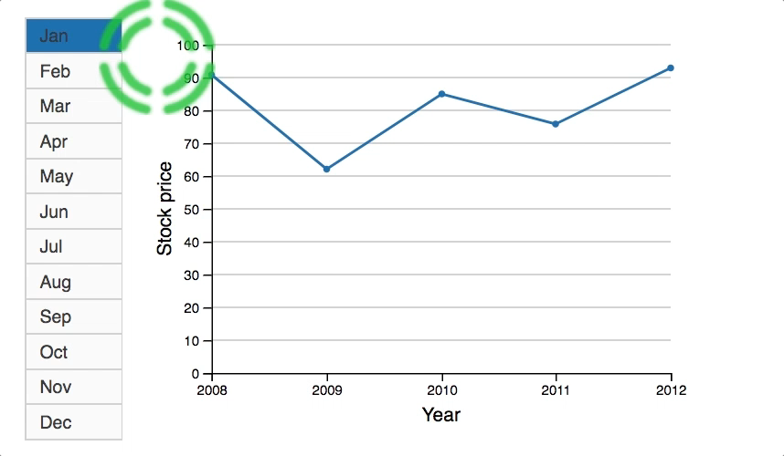
Alternative: Asynchronous Interaction
Immediate rendering
  out-of-order response arrival
  lower-latency feedback
Confusing!
  How, specifically?

Slide 30

User State
Buttons
Responses
ButtonID | X_range | Y_range | API | args
1 | [13,73] | [10,20] | fetch | [‘March’]
API Name | call_Time | results
fetch | 22 | [6, 13, …]
⨝
Requests
On_display
Buttons I pushed
Requests I caused
Responses on display
API name | timestamp | arguments
fetch | 21 | [‘June’]
fetch | 22 | [‘March’]
fetch | 23 | [‘May’]
month | call_time | results
‘June’ | 21 | [24, 16, …]
‘May’ | 23 | [14, 22, …]
‘March’ | 22 | [6, 13, …]

Slide 31
User State
Buttons
Responses
ButtonID | X_range | Y_range | API | args
1 | [13,73] | [10,20] | fetch | [‘March’]
API Name | call_Time | results
fetch | 22 | [6, 13, …]
⨝
Requests
On_display
Buttons I pushed
Requests I caused
Responses on display
Correspondences between
requests and responses
API name | timestamp | arguments
fetch | 21 | [‘June’]
fetch | 22 | [‘March’]
fetch | 23 | [‘May’]
month | call_time | results
‘June’ | 21 | [24, 16, …]
‘May’ | 23 | [14, 22, …]
‘March’ | 22 | [6, 13, …]

Slide 32
User State
Typical assumption: in the user’s head
Buttons I pushed
Requests I caused
Responses on display
Correspondences between
requests and responses
ButtonID | X_range | Y_range | API | args
1 | [13,73] | [10,20] | fetch | [‘March’]
API name | timestamp | arguments
fetch | 21 | [‘June’]
fetch | 22 | [‘March’]
fetch | 23 | [‘May’]
month | call_time | results
‘June’ | 21 | [24, 16, …]
‘May’ | 23 | [14, 22, …]
‘March’ | 22 | [6, 13, …]

Slide 33
User State: the Serial Case
Reasonable assumption: in the user’s head
Buttons I pushed (1)
Requests I caused (1)
Responses on display (1)
Correspondences between
requests and responses
ButtonID | X_range | Y_range | API | args
1 | [13,73] | [10,20] | fetch | [‘March’]
API name | timestamp | arguments
fetch | 21 | [‘June’]
fetch | 22 | [‘March’]
fetch | 23 | [‘May’]
month | call_time | results
‘June’ | 21 | [24, 16, …]
‘May’ | 23 | [14, 22, …]
‘March’ | 22 | [6, 13, …]

Slide 34
User State: the Async Case
Unreasonable assumption: in the user’s head
Buttons I pushed (7)
Requests I caused (5)
Responses on display (3)
Correspondences between
requests and responses
V_{t} M_{t}
Lossy memory of visual and
semantic history
Intermittent/Lossy
perception
ButtonID | X_range | Y_range | API | args
1 | [13,73] | [10,20] | fetch | [‘March’]
API name | timestamp | arguments
fetch | 21 | [‘June’]
fetch | 22 | [‘March’]
fetch | 23 | [‘May’]
month | call_time | results
‘June’ | 21 | [24, 16, …]
‘May’ | 23 | [14, 22, …]
‘March’ | 22 | [6, 13, …]
Latency

Slide 35
User State: the Async Case
ButtonID | X_range | Y_range | API | args
1 | [13,73] | [10,20] | fetch | [‘March’]
API Name | call_Time | results
Buttons I pushed (7)
Requests I caused (5)
Responses on display (3)
Correspondences between
requests and responses
API name | timestamp | arguments
fetch | 21 | [‘June’]
fetch | 22 | [‘March’]
fetch | 23 | [‘May’]
month | call_time | results
‘June’ | 21 | [24, 16, …]
‘May’ | 23 | [14, 22, …]
‘March’ | 22 | [6, 13, …]
V_{t} M_{t}
Lossy memory of visual and
semantic history
Intermittent/Lossy
perception
Latency

Slide 36
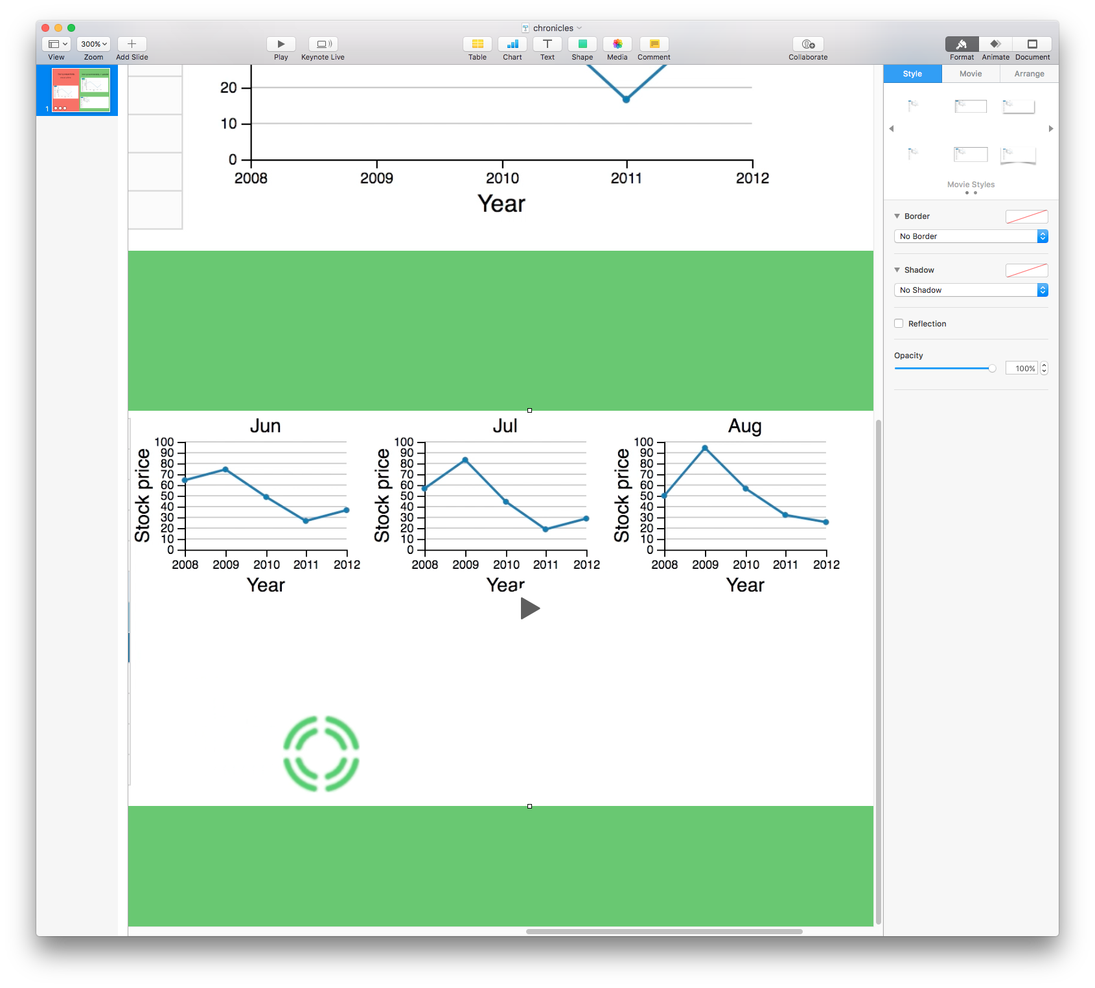
User State: the Async Case
Visualize the async state!
Buttons I pushed (7)
Requests I caused (5)
Responses on display (3)
Correspondences between
requests and responses
V_{t} M_{t}
Lossy memory of visual and
semantic history
ButtonID | X_range | Y_range | API | args
1 | [13,73] | [10,20] | fetch | [‘March’]
Intermittent/Lossy
perception
API name | timestamp | arguments
fetch | 21 | [‘June’]
fetch | 22 | [‘March’]
fetch | 23 | [‘May’]
month | call_time | results
‘June’ | 21 | [24, 16, …]
‘May’ | 23 | [14, 22, …]
‘March’ | 22 | [6, 13, …]
Latency

Slide 37
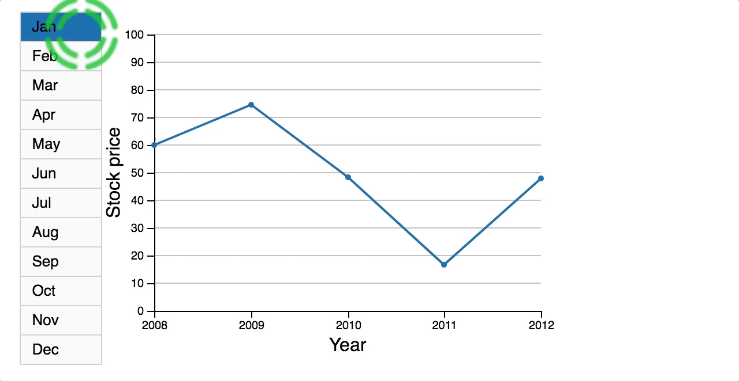
Chronicled Interaction: Overlay
Option 2: overlaid async chronicle
Immediate rendering
  out-of-order response arrival
  lower-latency feedback
Order-restoring visualization
  recency => color
  request/response correspondence: color
  bounded history

Slide 38
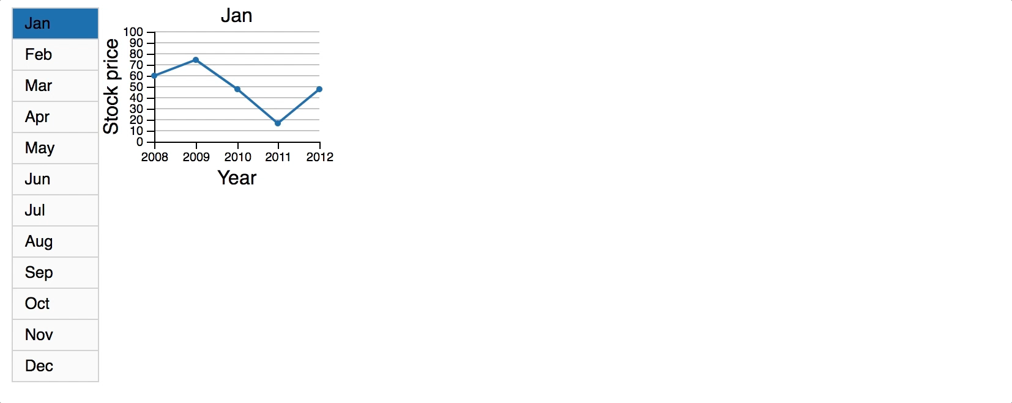
Chronicled Interaction: Small Multiples
Option 3: spatial async chronicle
Immediate rendering
  out-of-order response arrival
  lower-latency feedback
Order-restoring visualization
  recency => color
  request/response correspondence: label
  bounded history

Slide 39
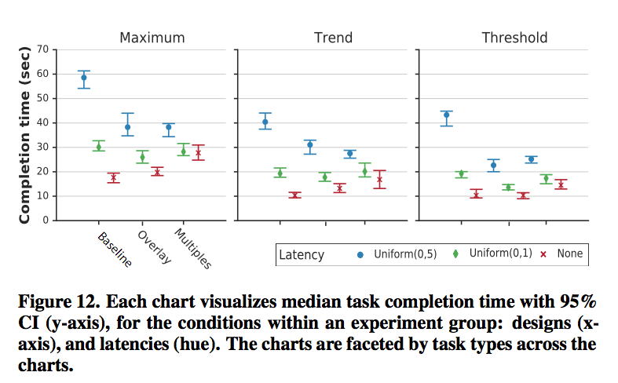
User Studies: Completion Time
High latency (blue):
  Chronicles improve completion time vs. Serial
Low latency (red):
  Serial dominates Chronicles

Slide 40
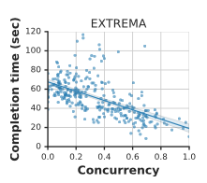
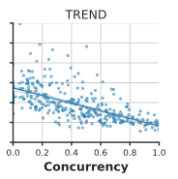
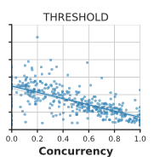
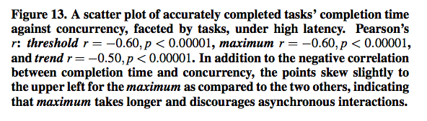
User Studies: Concurrency x Completion
With good interfaces, users work concurrently
  And finish faster
Bad interfaces cause self-serialization

Slide 41
Design Principles
“Progressive” visualization:
  Interaction history and output history both visualized (“chronicle”)
  Monotone evolution of vis tracks the march of time (dark → light → gone)
Program state is data: easy to visualize state, history
  System “internals”: request/response buffers
  Chronicled ordering of events
  Colors allow human processor to replicate the async join
All makes visualization easier to understand
  Analogous to how we think about distributed systems!

Slide 42
Outline
1
Perspective
2
Interactive as Distributed
3
Async Interaction
4
CALM Progress
5
More Progress

Slide 43
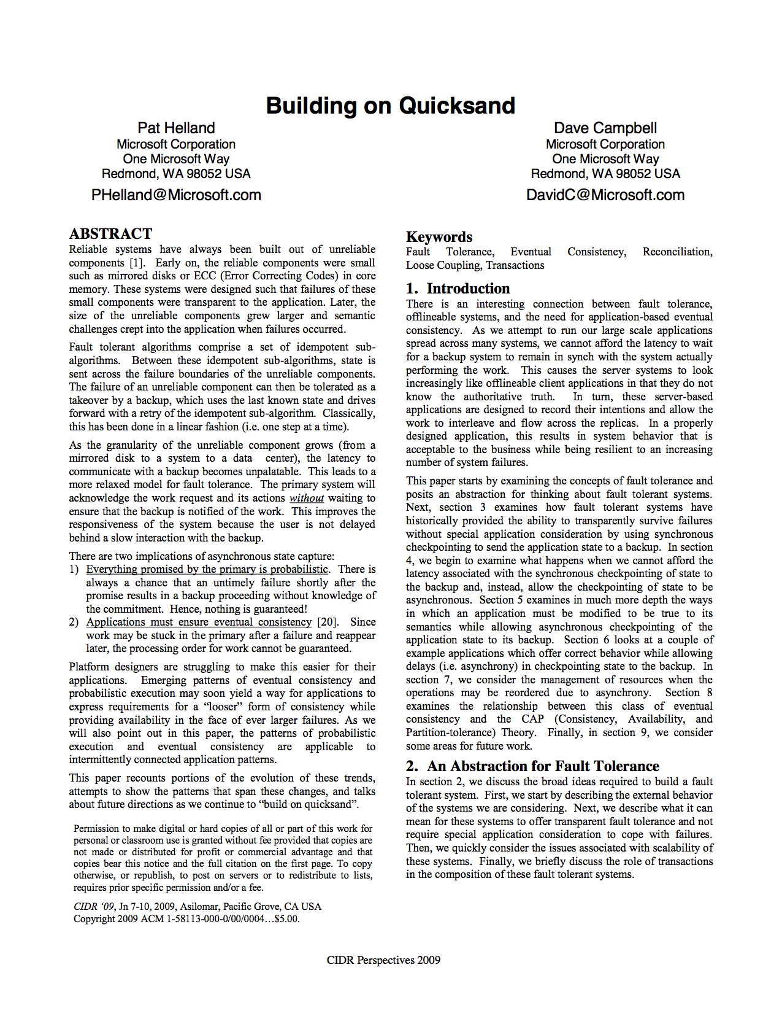
Design Patterns: “Building On Quicksand”
Experiences from Microsoft and Amazon in the late oughts
  E.g. Amazon Dynamo
[Helland/Campbell 2009]

Slide 44






-1
-1
Item | Count
Item | Count
0
1
1
2
1
1
1
1

Slide 45
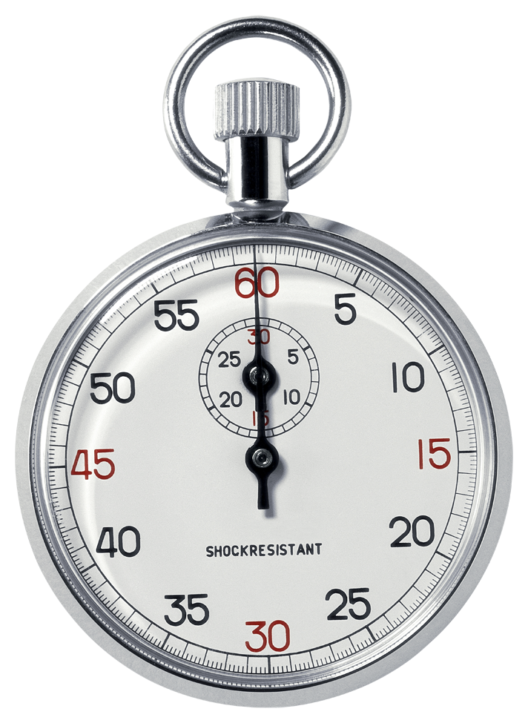
The Classical Solution
Coordination — i.e., global agreement
  Two-Phase Commit
  Paxos
  BSP barriers
Basically, ensure all nodes agree on separation in time

Slide 46
Item | Count
Item | Count

Slide 47
-1
-1
Item | Count
Item | Count

Slide 48
Item | Count
Item | Count
1
1
1
1

Slide 49
-1
-1
Item | Count
Item | Count
1
1
1
1

Slide 50
Item | Count
Item | Count
0
0

Slide 51
Item | Count
Item | Count
0
0

Slide 52
Item | Count
Item | Count
1
1

Slide 53
Item | Count
Item | Count
1
1
1
1

Slide 54
Item | Count
Item | Count
1
✔
1
1
1
1
1

Slide 55
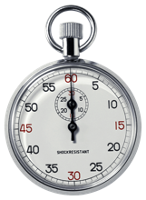
What’s So Slow ‘Bout Peace Love and Understanding?

Slide 56
What’s So Slow ‘Bout Peace Love and Understanding?

Slide 57
Design Pattern: ACID 2.0
Theme: Translate state mutation into
  A ssociative
  C ommutative
  I dempotent
  D istributed
  … logs of application-oriented requests

Slide 58
-1
-1
Notes:
Barrier at Checkout

Slide 59
Item | Count
Item | Count
1
1
✔
1
1
Notes:
Barrier at Checkout

Slide 60
Formalism: The CALM Theorem
[Hellerstein PODS ‘09]
[ANV PODS ‘11, JACM ‘13]
[ZGL PODS ‘12]
[AKN PODS14, JACM16]
Theorem: CALM (Consistency As Logical Monotonicity).
The following are equivalent computational classes:
  Problems that do not require coordination for distributed consistency
  Problems expressible in Monotonic Logic
Said differently:
Eventual Consistency Possible iff Problem is Monotone

Slide 61
The Expressive Power of CALM
Conjecture: Coordination-Free 𝍫 PTIME
  Via Immerman/Vardi (semi-positive Datalog with successor = PTIME)
In a better world, we’d probably never use/need coordination
  We are slaves to the legacy of Read/Write I/O assumptions

Slide 62
CALM Design Patterns
Many programs can be written monotonically
  Monotonic = Coordination-Free = Embarrassingly Parallel.
  No need for Lamport clocks, 2PC, “time” of any kind
Logic + Lattices (CRDTs)
  With lattice homomorphisms and monotone functions [CMA SOCC12]

Slide 63
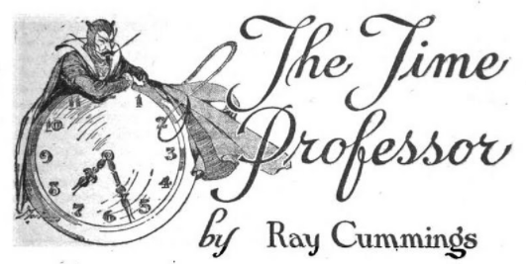

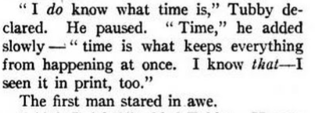
So What is Time For?

Slide 64
Back to the Point
What should be progressively rendered
  Visualizations you can make order- and batch-insensitive
What should be separated in time — or space?.
And why?!

Slide 65
Separation Can Be Good
We may want to demarcate “sessions” or “tasks”
  Really just a “partitioning key”, not ordering.
We may want to record a sequence
  Again, may simply be annotation data for human consumption
That’s OK! Humans exist in space and time
  Even if most tasks are embarassignly parallel

Slide 66

Layout in Time and Space
Either can be used for sequencing/partitioning
Partition in space lets a few states be “seen at the same time”

Slide 67
Implications: Systems, Algorithms and Visualizations
Many computations can be made progressive (CALM)
Monotonic = easier to visualize & understand
Time and Space can be used to organize independent things
  Even if they’re progressive
Some things are truly sequenced
  The classic: state mutation in time
    Though this is often artificial
  Exponential problems

Slide 68
Outline
1
Perspective
2
Interactive as Distributed
3
Async Interaction
4
CALM Progress
5
More Progress

Slide 69
What About Approximation?
Where is the monotonicity?
  Count
  Average?
  ε

Slide 70
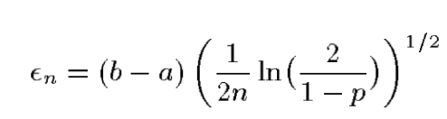
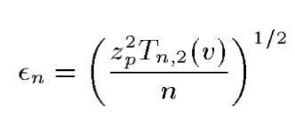
Confidence Bounds for Average
Hoeffding:
CLT-based:

Slide 71
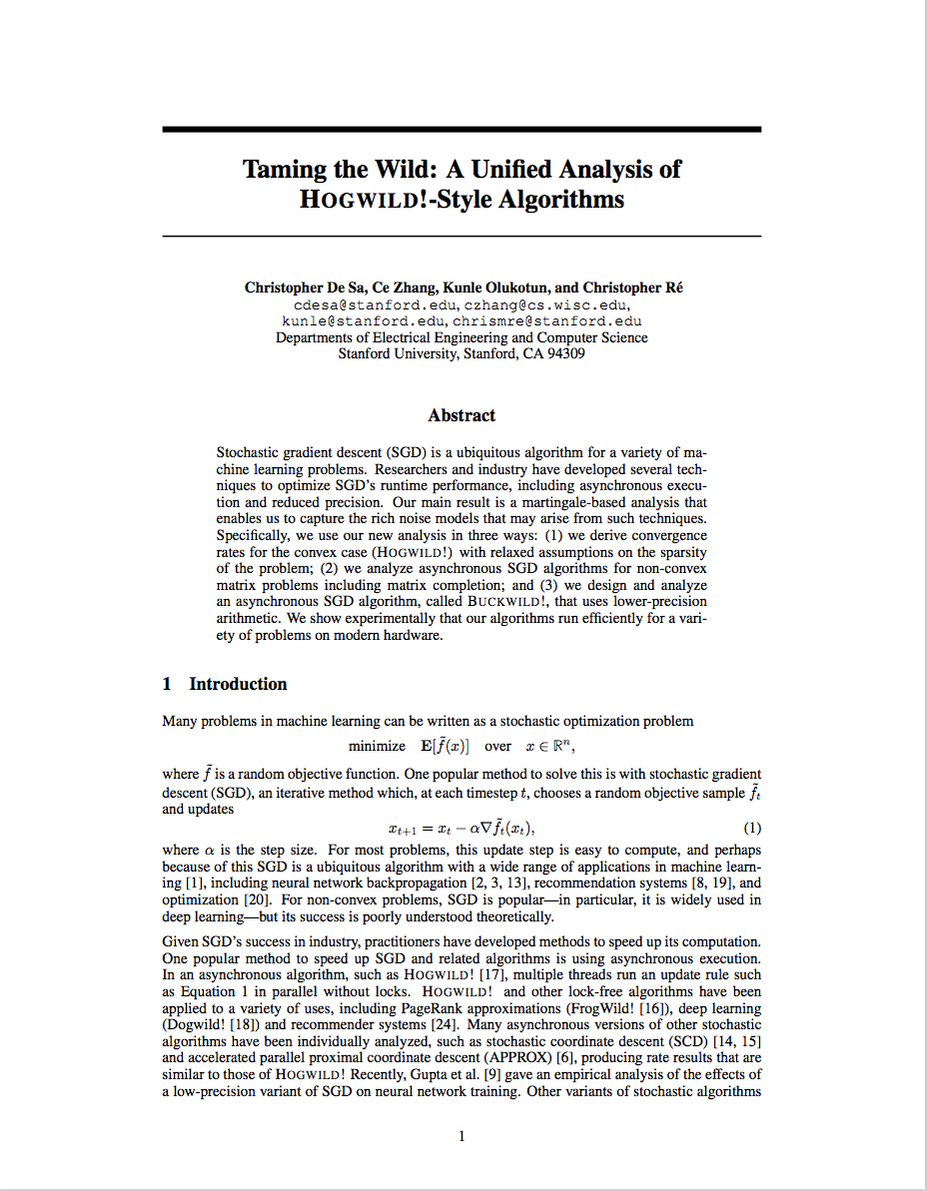
More Hints
Sub/Super-martingales
  Monotonicity of Expectation
  “Stochastic CALM”

Slide 72
Questions/Challenges I: End-to-End Progressive
Consistent Progressive Perception
  Establish the notion of “consistency” between human and computational models
  Formalize the connection between perception, monotonicity and coordination
What needs to be Progressive?
  Coordination-free systems
  Monotonicity of approximation
  Monotonicity of user experience

Slide 73
Questions/Challenges II
Pragmatics
  What tasks merit progressive feedback?
  Separately, what tasks merit progressive approximation?
Interaction and Control Loops
  When does user input suggest starting “a new session” (a clock tick)?
  How does the biased human input channel interact with approximation rigor?
  Are humans more likely to perform truly non-monotone tasks, and should we support that explicitly?

Slide 74
Takeaways
Joe Hellerstein
hellerstein@berkeley.edu
@joe_hellerstein
Consider Systems, Statistics and UX
Online Results, Aggregations:
  A special case of streaming computation
HCI is a Distributed System
  Worry about consistency, reordering, latency variance
CALM makes things much easier
  Monotonicity implies coordination-freeness
  At system, stats and UX levels

Slide 75
Citations
Joe Hellerstein

Slide 76
Citations
[ACC+10a] Peter Alvaro, Tyson Condie, Neil Conway, et al. Boom analytics: exploring data-centric, declarative programming for the cloud. In Eurosys, 2010.
[ACC10b] Peter Alvaro, Tyson Condie, Neil Conway, et al. I do declare: consensus in a logic language. NetDB, 2010.
[ACHM11] Peter Alvaro, Neil Conway, Joseph M Hellerstein, and William R Marczak. Consistency analysis in Bloom: a CALM and collected approach. In CIDR 2011.
[AKNZ16] Tom J Ameloot, Bas Ketsman, Frank Neven, and Daniel Zinn. Weaker forms of monotonicity for declarative networking: a more fine-grained answer to the CALM-conjecture. ACM TODS, 40(4):21, 2016.
[ANVdB13] Tom J Ameloot, Frank Neven, and Jan Van den Bussche. Relational transducers for declarative networking. JACM, 60(2):15, 2013.
[AtCG+15] Molham Aref, Balder ten Cate, Todd J Green, et al. Design and implementation of the LogicBlox system. In SIGMOD, 2015
. [CCHM08] Tyson Condie, David Chu, Joseph M Hellerstein, and Petros Maniatis. Evita Raced: metacompilation for declarative networks. PVLDB 1(1):1153–1165, 2008.
[CMA+12] Neil Conway, William R Marczak, Peter Alvaro, et al. Logic and lattices for distributed programming. In ACM SoCC, 2012.
[CMN83] Stuart Card, Thomas Moran, and Allen Newell. The Psychology of Human Computer Interaction. CRC, 1983.
[CPT+07] David Chu, Lucian Popa, Arsalan Tavakoli, et al. The design and implementation of a declarative sensor network system. In ACM Sensys, 2007.
[HC09] Pat Helland and David Campbell. Building on quicksand. arXiv preprint arXiv:0909.1788, 2009.
[Hel10] Joseph M. Hellerstein. The declarative imperative: experiences and conjectures in distributed logic. SIGMOD Record, 39(1):5–19, 2010.

Slide 77
Citations, Cont.
[LCH+05] Boon Thau Loo, Tyson Condie, Joseph M. Hellerstein, et al. Implementing declarative overlays. In SOSP, 2005.
[LPC+12] Cheng Li, Daniel Porto, Allen Clement, Johannes Gehrke, Nuno M Preguiça, and Rodrigo Rodrigues. Making geo-replicated systems fast as possible, consistent when necessary. In OSDI, 2012.
[LPS10] Mihai Letia, Nuno Preguiça, and Marc Shapiro. Consistency without concurrency control in large, dynamic systems. SOSP, 2010.
[SPBZ11] Marc Shapiro, Nuno Preguiça, Carlos Baquero, and Marek Zawirski. Convergent and commutative replicated data types. Bulletin-European Association for Theoretical Computer Science, (104):67–88, 2011.
[ZGL12] Daniel Zinn, Todd J Green, and Bertram Ludäscher. Win-move is coordination-free (sometimes). In PODS, pages 99–113. ACM, 2012.
[ZST+10] Wenchao Zhou, Micah Sherr, Tao Tao, Xiaozhou Li, Boon Thau Loo, and Yun Mao. Efficient querying and maintenance of network provenance at internet-scale. In SIGMOD, 2010.

Slide 78
Backup Slides
Joe Hellerstein

Slide 79
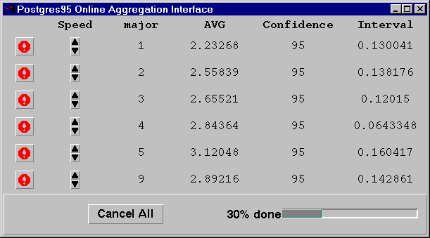
The First Online Aggregation UI
Continuous feedback
  approximation
  confidence
  progress
Ongoing control of sampling
Continuous feedback
  approximation
  confidence
  progress
Ongoing control of sampling
With thanks to Andrew MacBride, 1996

